Slide 1
Python Basics

Slide 2




Highlights
Example
Question
Notes
Coding Style

Slide 3

Roadmap
Introduction
Objects, Variables, and Data Types
Strings, List and Dictionary
Control Flow Statements

Slide 4



Run! Python, Run!
Installation
Python
Jupyter Notebook (Anaconda)
IDEs (Pycharm/Spyder)

Slide 5
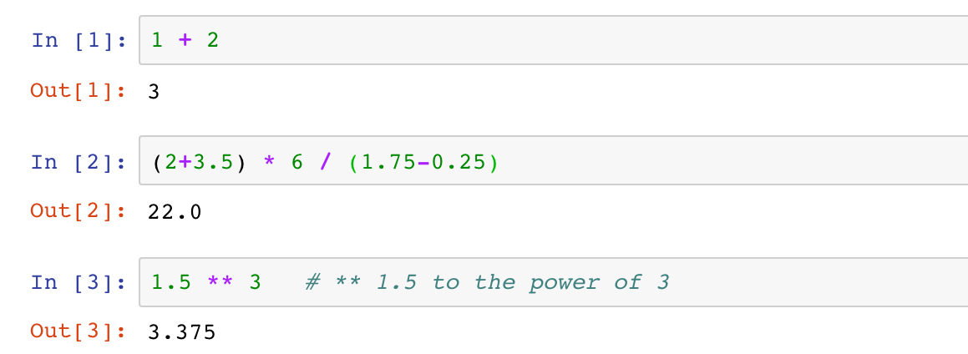
Run! Python, Run!
Interactive Shell Combining Code with Text
Try Python as a scientific calculator
Python arithmetic operators
Python code is executed line by line (cell by cell)

Slide 6

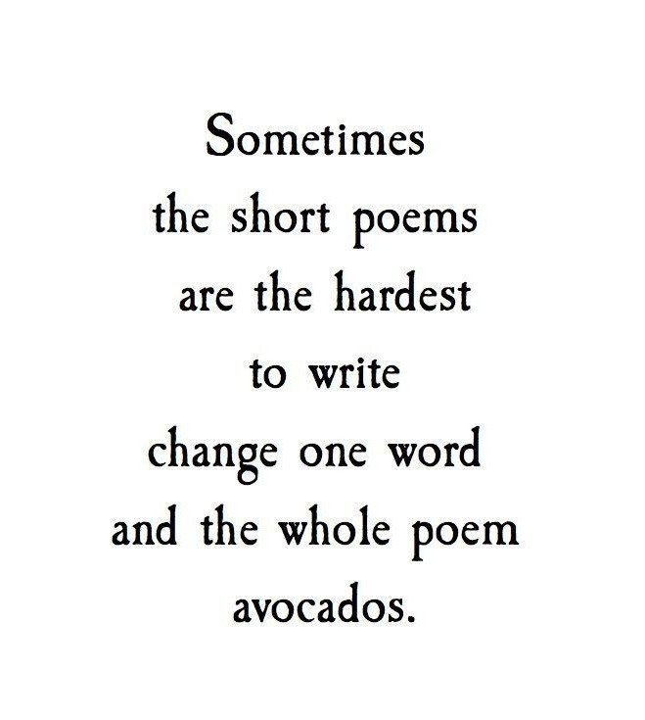


Run! Python, Run!
Interactive Shell Combining Code with text
Try Python as a scientific calculator
Python arithmetic operators
Python code is executed line by line (cell by cell)
Not allowed!!
Notes
Splitting a statement into multiple lines is not allowed.

Slide 7

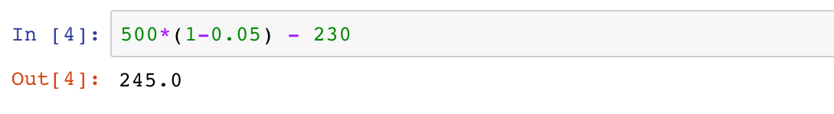
Run! Python, Run!
Interactive Shell Combining Code with Text
Try Python as a scientific calculator
Python arithmetic operators
Python code is executed line by line (cell by cell)
Example 1
A grocery store had 500 packs of cookies in storage. Among the total storage, 5% were dumped due to expiration, and another 230 packs were sold. Calculate how many packs of cookies are left in the grocery store.

Slide 8
Roadmap
Introduction
Objects, Variables, and Data Types
Strings, List and Dictionary
Control Flow Statements

Slide 9

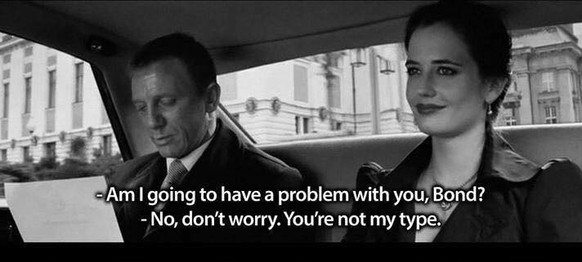
Objects, Variables, and Data Types

Slide 10
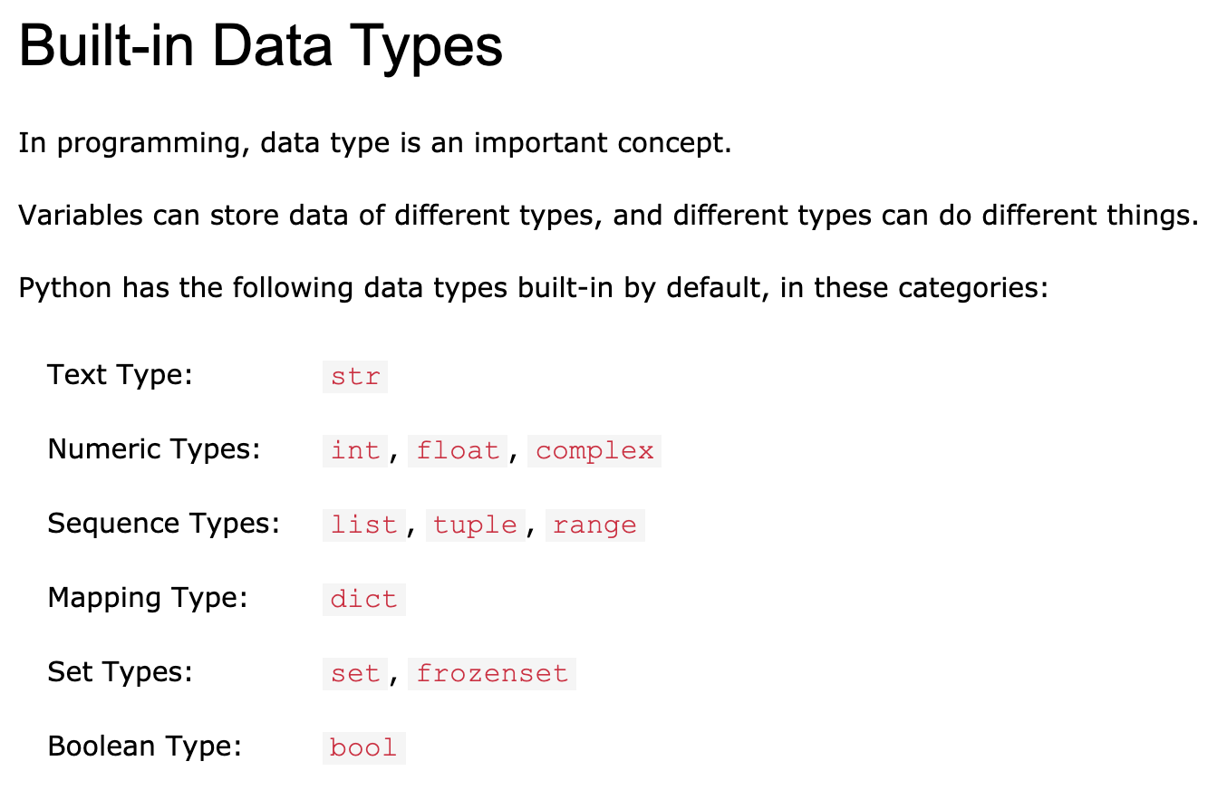
Objects, Variables, and Data Types
An Overview of Datatypes:
https://www.w3schools.com/python/python_datatypes.asp

Slide 11
Objects, Variables, and Data Types
Objects
Almost everything in Python is an object
Every object has a value and a type

Slide 12
Objects, Variables, and Data Types
Variables and Assignment Statements
Variables gives names to objects
Reuse the same value
Improve the readability
Enable control flow

Slide 13

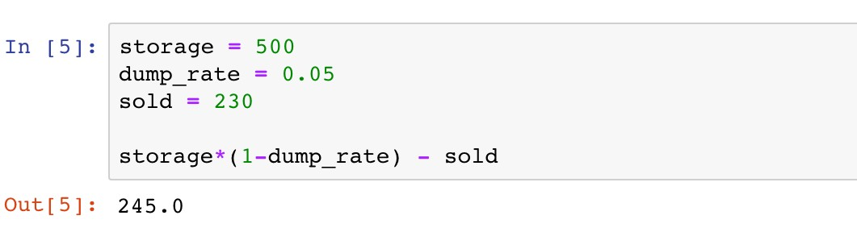
Objects, Variables, and Data Types
Variables and Assignment Statements
The value of a variable can be retrieved by invoking the name
Example 1
A grocery store had 500 packs of cookies in storage. Among the total storage, 5% were dumped due to expiration, and another 230 packs were sold. Calculate how many packs of cookies are left in the grocery store.

Slide 14
Objects, Variables, and Data Types
Variables and Assignment Statements
Assignment operator “="
Example 1
A grocery store had 500 packs of cookies in storage. Among the total storage, 5% were dumped due to expiration, and another 230 packs were sold. Calculate how many packs of cookies are left in the grocery store.

Slide 15
Objects, Variables, and Data Types
Variables and Assignment Statements
Variable(s): name(s) on the left
Example 1
A grocery store had 500 packs of cookies in storage. Among the total storage, 5% were dumped due to expiration, and another 230 packs were sold. Calculate how many packs of cookies are left in the grocery store.

Slide 16


Objects, Variables, and Data Types
Variables and Assignment Statements
Variable(s): name(s) on the left
Example 1
A grocery store had 500 packs of cookies in storage. Among the total storage, 5% were dumped due to expiration, and another 230 packs were sold. Calculate how many packs of cookies are left in the grocery store.
Notes
Only one “word”
Only consist of letters, numbers, and underscores
Cannot begin with a number
Avoid contradictions with Python keywords

Slide 17
Objects, Variables, and Data Types
Variables and Assignment Statements
Value(s): expression(s) on the right
Example 1
A grocery store had 500 packs of cookies in storage. Among the total storage, 5% were dumped due to expiration, and another 230 packs were sold. Calculate how many packs of cookies are left in the grocery store.

Slide 18
Objects, Variables, and Data Types
Variables and Assignment Statements
The value of a variable can be retrieved by invoking the name
Example 1
A grocery store had 500 packs of cookies in storage. Among the total storage, 5% were dumped due to expiration, and another 230 packs were sold. Calculate how many packs of cookies are left in the grocery store.

Slide 19
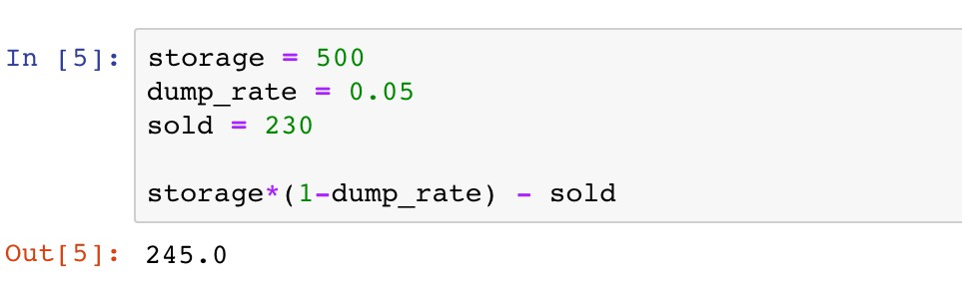
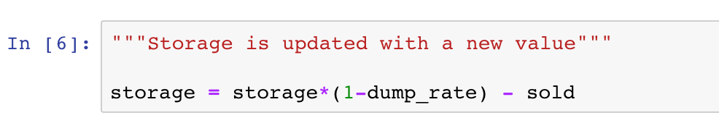
Objects, Variables, and Data Types
Variables and Assignment Statements
Assign new values to variables
500
The new value 245 is assigned as the old one is forgotten

Slide 20


Objects, Variables, and Data Types
Variables and Assignment Statements
Assign new values to variables
Coding Style
PEP 8 Style Guide:
Function and variable names
Whitespace in expressions and statements

Slide 21

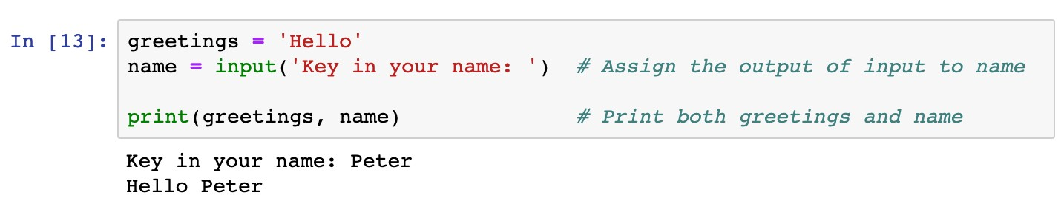
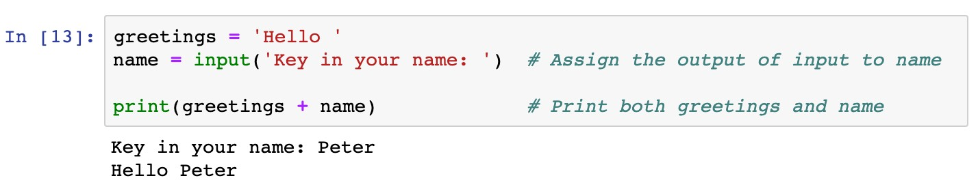
Objects, Variables, and Data Types
Variables and Assignment Statements
Assign values of function outputs to variables
Example 2
Use the “input” function in assignment statements
Output of the input function is the text given by users
Message displayed when users key in the text
Functions: a block of organized, reusable code that is used to perform a single, related action

Slide 22

Objects, Variables, and Data Types
Variables and Assignment Statements
Python vs Math
Question
Which assignment statement is correct?
x + y = 2
x * y = 1
2 = x
xy = 2
None of the above is correct

Slide 23
Objects, Variables, and Data Types
Variables and Assignment Statements
Other assignment operations
Operators
Remarks
Examples
+=
Equivalent to x Equivalent to x | = = | x x | + - | y y | x x | += -= | y y
Equivalent to x | = | x | * | y | x | *= | y
Equivalent to x | = | x | / | y | x | /= | y
-=
*=
/=
**=
Equivalent to x
= x**y
x **= y

Slide 24
Objects, Variables, and Data Types
Basic Built-in Data Types
Various types of data may be diﬀerent in nature
Data types determine how functions and operators work
Data types can be retrieved by function
type()

Slide 25
Objects, Variables, and Data Types
Basic Built-in Data Types
Numeric types
: signed integers
int
✓
float
: floating point real numbers
✓
long
and
complex:
long integers and complex numbers (not
covered in this course)

Slide 26
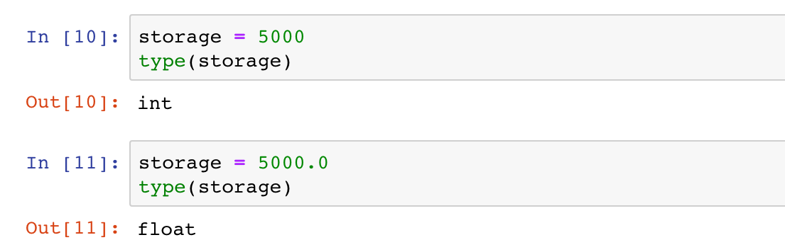
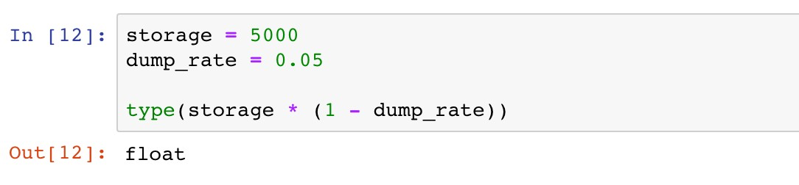
Objects, Variables, and Data Types
Basic Built-in Data Types
Numeric types

Slide 27
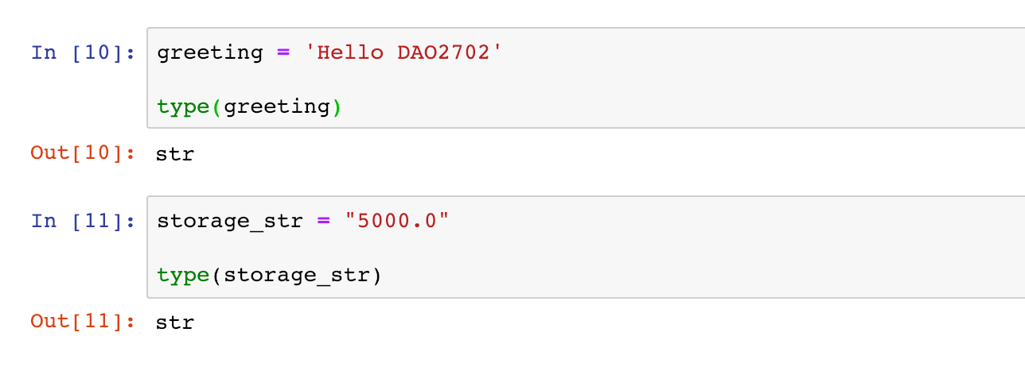
Objects, Variables, and Data Types
Basic Built-in Data Types
String:
str
Single or double quotation marks used in defining strings
Operators and can be used to manipulate strings
+
*

Slide 28

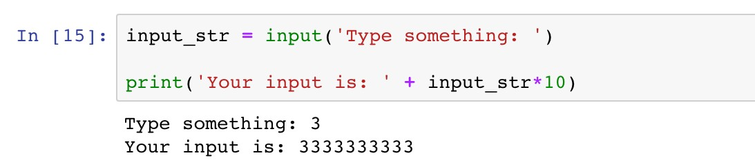
Objects, Variables, and Data Types
Basic Built-in Data Types
String:
str
Example 3
The function “input” enables users to type in a string of characters. Print a message “You input is:”, followed by the input string repeated ten times.
input_str is a string, so “+” combines strings, and “*” replicates strings.

Slide 29

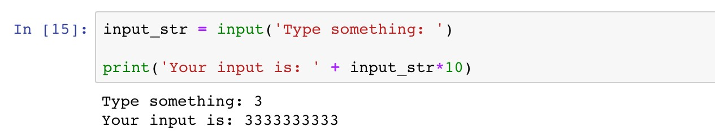
Objects, Variables, and Data Types
Basic Built-in Data Types
String:
str
HOW ABOUT MULTIPLYING THE INPUT NUMBER BY TEN?

Slide 30

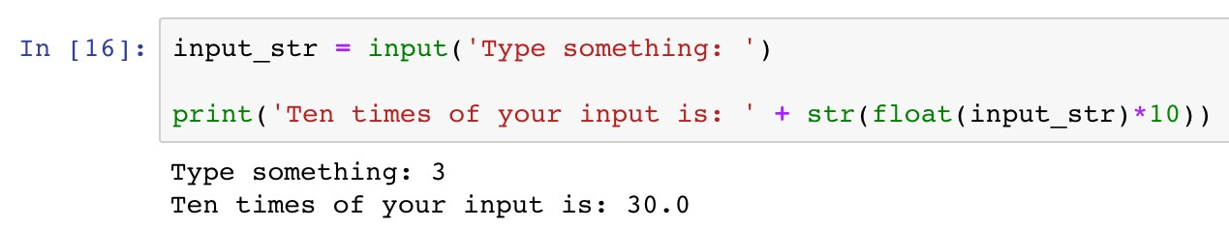
Objects, Variables, and Data Types
Data Type Conversion
Enable manipulating data diﬀerently
Use type name as the conversion function
DATA TYPE CONVERSION!!
Convert the floating point number back to a string
Convert the string to a floating point number

Slide 31
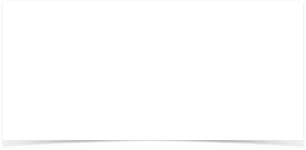
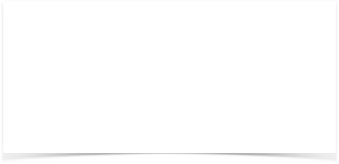
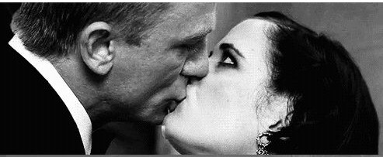
Objects, Variables, and Data Types
Data Type Conversion
BEFORE TYPE CONVERSION
AFTER TYPE CONVERSION

Slide 32

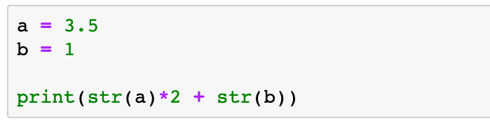
Objects, Variables, and Data Types
Data Type Conversion
Question
What is the output message of the following code?
A. 8
B. 3.53.51
C. 71
D. 3.53.51.0

Slide 33
Roadmap
Introduction
Objects, Variables, and Data Types
Strings, List and Dictionary
Control Flow Statements

Slide 34
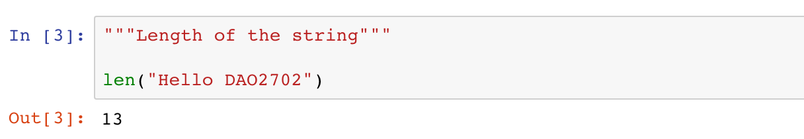
Strings
Strings are collections of characters
Length of a string (the number of characters)
13 characters
H | e | l | l | o |  | D | A | O | 2 | 7 | 0 | 2
0 1 2 3 4 5 6 7 8 9 10 11 12
-13 -12 -11 -10 -9 -8 -7 -6 -5 -4 -3 -2 -1

Slide 35
Strings
Strings are collections of characters
Accessing individual characters
13 characters
H | e | l | l | o |  | D | A | O | 2 | 7 | 0 | 2
0 1 2 3 4 5 6 7 8 9 10 11 12
-13 -12 -11 -10 -9 -8 -7 -6 -5 -4 -3 -2 -1

Slide 36
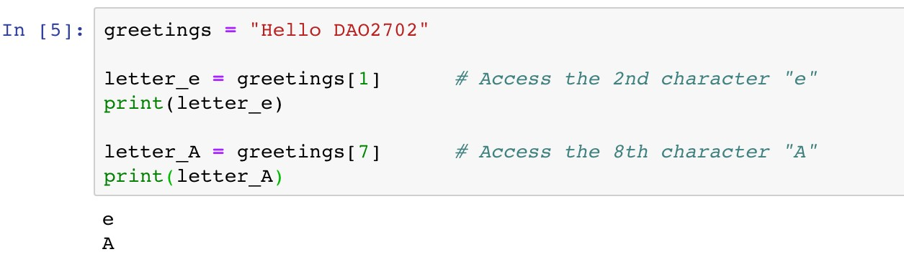
Strings
Strings are collections of characters
Accessing individual characters
13 characters
H |  | l | l | o |  | D |  | O | 2 | 7 | 0 | 2
0 |  | 2 | 3 | 4 | 5 | 6 |  | 8 | 9 | 10 | 11 | 12
e 1
A 7
Index
-13 -12 -11 -10 -9 -8 -7 -6 -5 -4 -3 -2 -1

Slide 37
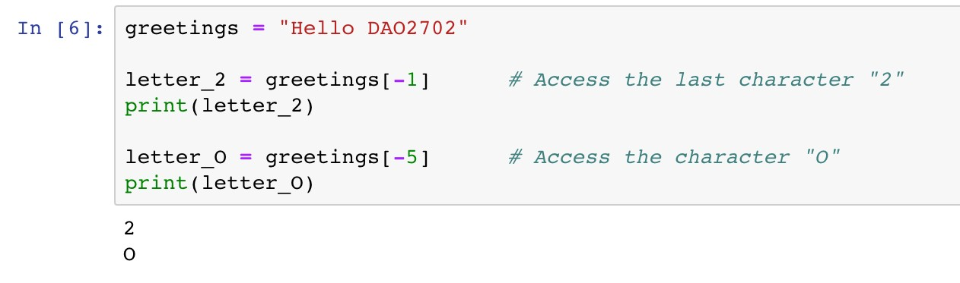
Strings
Strings are collections of characters
Accessing individual characters
13 characters
H | e | l | l | o |  | D | A |  | 2 | 7 | 0
0 | 1 | 2 | 3 | 4 | 5 | 6 | 7 |  | 9 | 10 | 11
-13 | -12 | -11 | -10 | -9 | -8 | -7 | -6 |  | -4 | -3 | -2
O 8
-5
2
12
-1
Index Index from rear

Slide 38
Strings
Strings are collections of characters
Slicing expression: access a subset of a string
13 characters
 |  | D | A | O | 2 | 7 | 0 | 2
 | 5 | 6 | 7 | 8 | 9 | 10 | 11 | 12
 | -8 | -7 | -6 | -5 | -4 | -3 | -2 | -1
H e l l o 0 1 2 3 4
-13 -12 -11 -10 -9
Index Index from rear

Slide 39
Strings
Strings are collections of characters
Slicing expression: access a subset of a string
[start:stop:step]
Arguments | Remarks | Default Values
start | The first index of the slice | 0
stop | The index before which the slice stops | Length of the string
step | The step length of the slice | 1

Slide 40
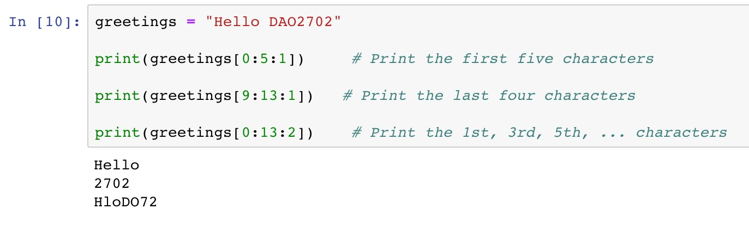
Strings
Strings are collections of characters
Slicing expression: access a subset of a string
13 characters
Index
 |  | D | A | O | 2 | 7 | 0 | 2
 | 5 | 6 | 7 | 8 | 9 | 10 | 11 | 12
H e l l o 0 1 2 3 4
-13 -12 -11 -10 -9 -8 -7 -6 -5 -4 -3 -2 -1
start
stop

Slide 41
Strings
Strings are collections of characters
Slicing expression: access a subset of a string
13 characters
Index
H | e | l | l | o |  | D | A | O
0 | 1 | 2 | 3 | 4 | 5 | 6 | 7 | 8
2 7 0 2
9 10 11 12
-13 -12 -11 -10 -9 -8 -7 -6 -5 -4 -3 -2 -1
start
stop

Slide 42
Strings
Strings are collections of characters
Slicing expression: access a subset of a string
13 characters
Index
 | e |  | l |  |  |  | A |  | 2 |  | 0
 | 1 |  | 3 |  | 5 |  | 7 |  | 9 |  | 11
H 0
l 2
o 4
D 6
O 8
7
10
2
12
-13 -12 -11 -10 -9 -8 -7 -6 -5 -4 -3 -2 -1
start
stop
step

Slide 43
Strings
Strings are collections of characters
Slicing expression
Arguments
Default Values
start 0
Unspecified
stop
Length of the string
step 1
[0:5:1]
[0:5:1]
[:5]
13 characters
Index
 |  | D | A | O | 2 | 7 | 0 | 2
 | 5 | 6 | 7 | 8 | 9 | 10 | 11 | 12
H e l l o 0 1 2 3 4
-13 -12 -11 -10 -9 -8 -7 -6 -5 -4 -3 -2 -1
start
stop

Slide 44

Strings
Strings are collections of characters
Slicing expression
Arguments
Default Values
start
0
Unspecified
stop Length of the string
step 1
[9:13:1]
[9:13:1]
[9:]
[-4:13:1]
[-4:13:1]
[-4:]
13 characters
Index Index from rear
H | e | l | l | o |  | D | A | O
0 | 1 | 2 | 3 | 4 | 5 | 6 | 7 | 8
-13 | -12 | -11 | -10 | -9 | -8 | -7 | -6 | -5
2 7 0 2
9 10 11 12
-4 -3 -2 -1
start
stop

Slide 45
Strings
Strings are collections of characters
Slicing expression
Arguments Default Values
step 1
start 0
Unspecified
stop Length of the string
[0:13:2]
[0:13:2]
[::2]
13 characters
Index
 | e |  | l |  |  |  | A |  | 2 |  | 0
 | 1 |  | 3 |  | 5 |  | 7 |  | 9 |  | 11
H 0
l 2
o 4
D 6
O 8
7
10
2
12
-13 -12 -11 -10 -9 -8 -7 -6 -5 -4 -3 -2 -1
start
stop
step

Slide 46

Strings
Strings are collections of characters
Slicing expression: access a subset of a string
Notes
A common mistake is assuming that the last index of the slice is stop. Please be very careful that the last index should be the last available integer before stop.

Slide 47

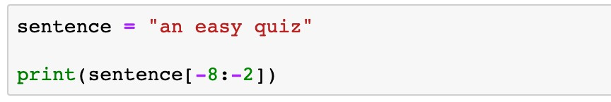
Strings
Strings are collections of characters
Indexing and slicing expression
Question
What is the printed message of the following code?
easy q
easy
asy qu
asy qui

Slide 48
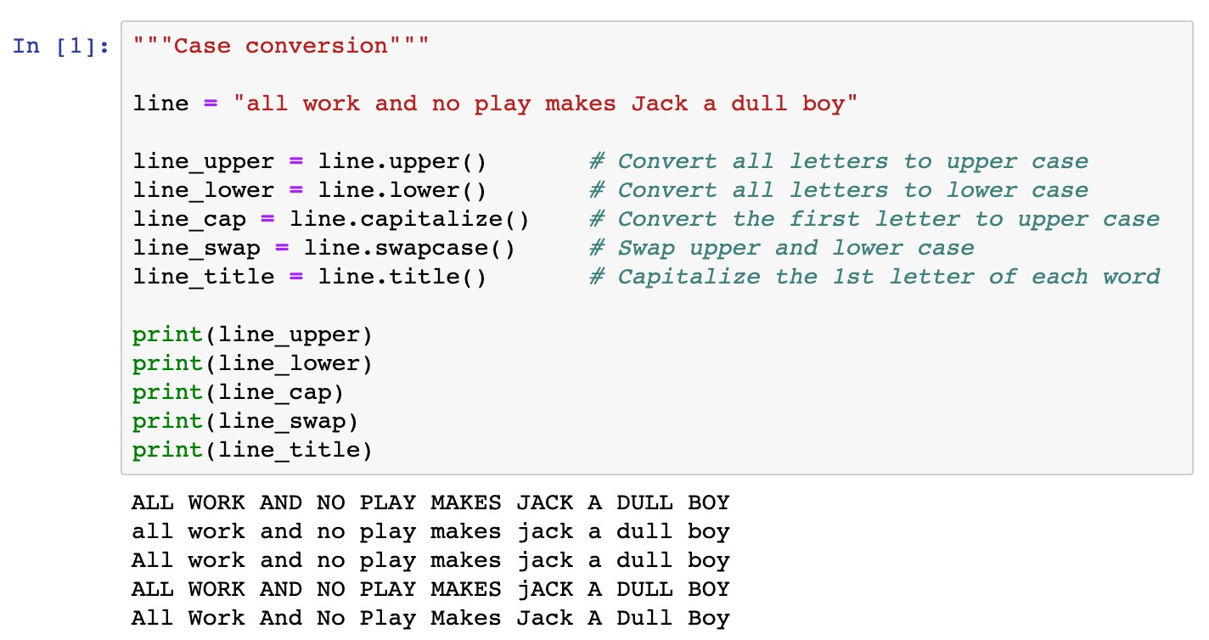
Strings
Methods of strings
Case conversion

Slide 49
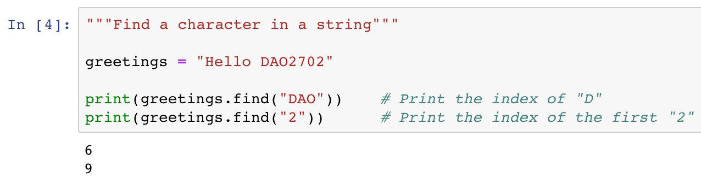
Strings
Methods of strings
Search items in a string
This method returns -1 if the given item cannot be found
13 characters
H | e | l | l | o |  | D | A | O | 2 | 7 | 0 | 2
0 | 1 | 2 | 3 | 4 | 5 | 6 | 7 | 8 | 9 | 10 | 11 | 12
-13 -12 -11 -10 -9 -8 -7 -6 -5 -4 -3 -2 -1

Slide 50
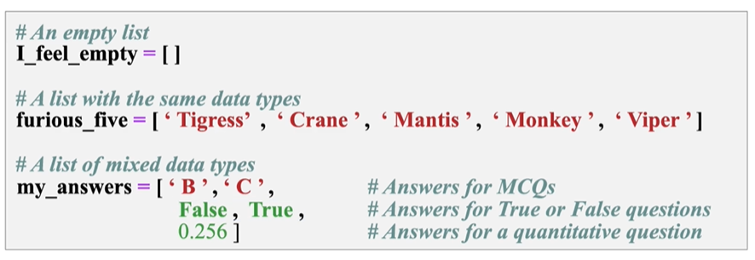
List
List
a collection which is ordered and changeable. Allows duplicate members
0 1 2 3 4 5 6 7 8 9 10 11 12
-13 -12 -11 -10 -9 -8 -7 -6 -5 -4 -3 -2 -1

Slide 51
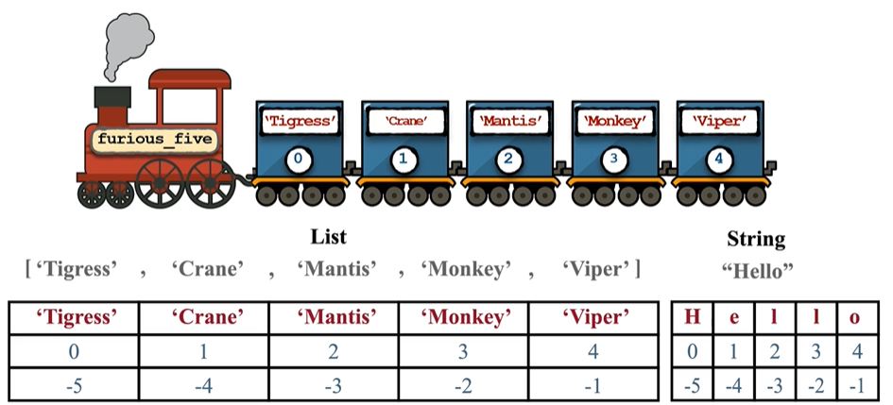
Similarities between list and strings
Similarity: Indexing and slicing
0 1 2 3 4 5 6 7 8 9 10 11 12
-13 -12 -11 -10 -9 -8 -7 -6 -5 -4 -3 -2 -1

Slide 52
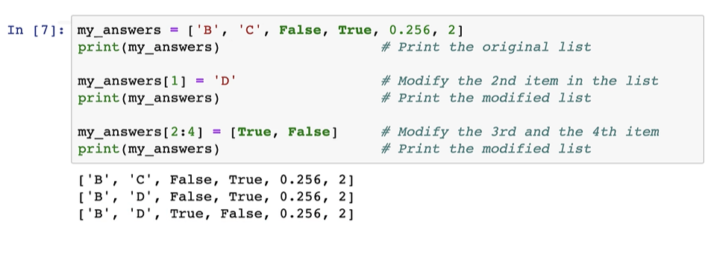
Differences between list and strings
Mutability: element-wise segment
If you try to change some characters in a string via indexing and slicing, an error message will be given!
0 1 2 3 4 5 6 7 8 9 10 11 12
-13 -12 -11 -10 -9 -8 -7 -6 -5 -4 -3 -2 -1

Slide 53
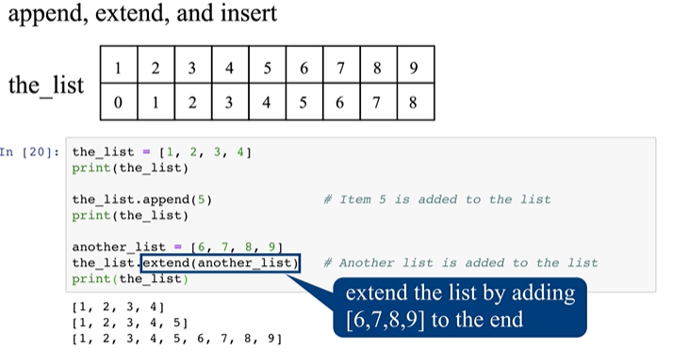
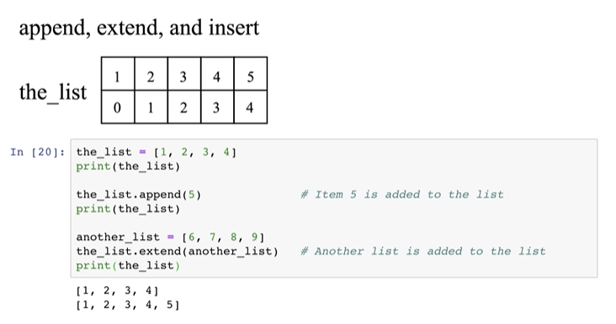
List methods
List
Append, extend a list
0 1 2 3 4 5 6 7 8 9 10 11 12
-13 -12 -11 -10 -9 -8 -7 -6 -5 -4 -3 -2 -1

Slide 54
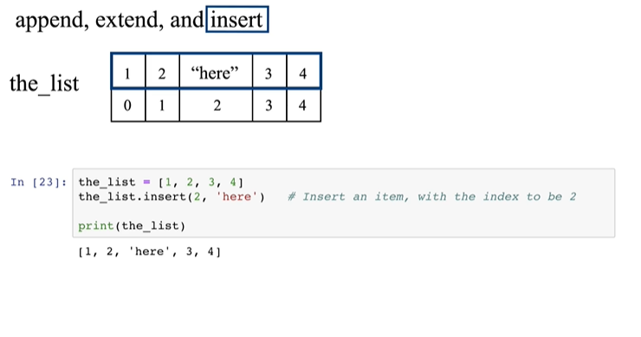
List methods
List
Insert an element to a list
0 1 2 3 4 5 6 7 8 9 10 11 12
-13 -12 -11 -10 -9 -8 -7 -6 -5 -4 -3 -2 -1

Slide 55
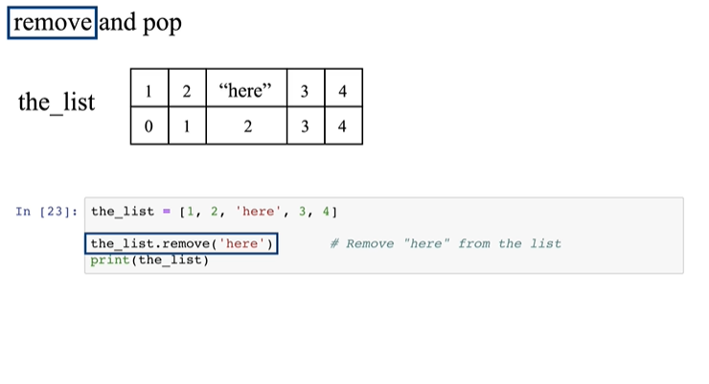
List methods
List
Remove an element from the list using remove()
0 1 2 3 4 5 6 7 8 9 10 11 12
-13 -12 -11 -10 -9 -8 -7 -6 -5 -4 -3 -2 -1

Slide 56
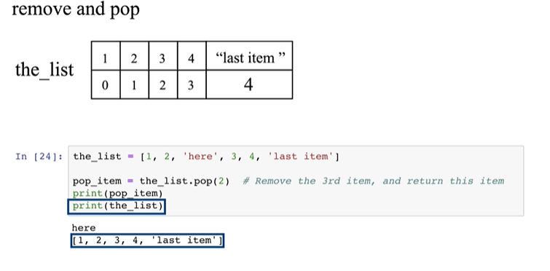
List methods
List
Remove an element from the list using pop()
0 1 2 3 4 5 6 7 8 9 10 11 12
-13 -12 -11 -10 -9 -8 -7 -6 -5 -4 -3 -2 -1

Slide 57
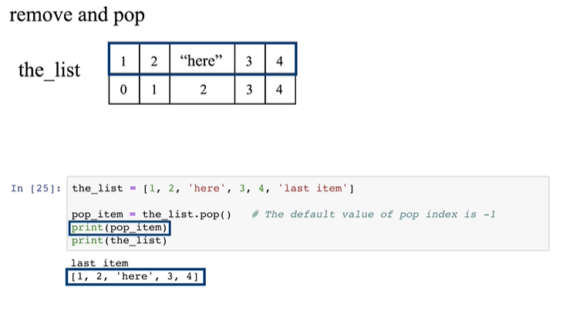
List methods
List
Remove an element from the list using pop()
0 1 2 3 4 5 6 7 8 9 10 11 12
-13 -12 -11 -10 -9 -8 -7 -6 -5 -4 -3 -2 -1

Slide 58
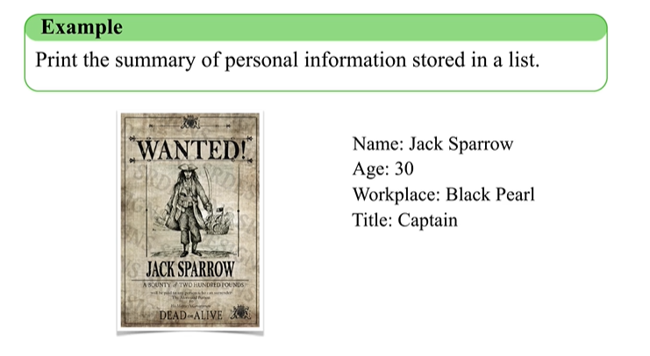
Dictionary
Dictionary
0 1 2 3 4 5 6 7 8 9 10 11 12
-13 -12 -11 -10 -9 -8 -7 -6 -5 -4 -3 -2 -1

Slide 59
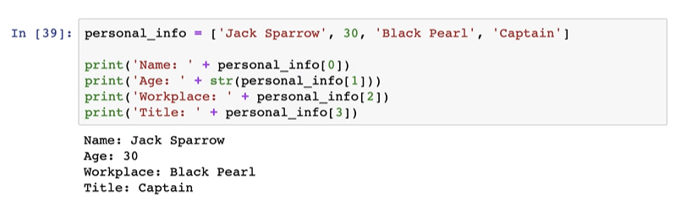
Dictionary
Dictionary
Is this a good method?
0 1 2 3 4 5 6 7 8 9 10 11 12
-13 -12 -11 -10 -9 -8 -7 -6 -5 -4 -3 -2 -1

Slide 60
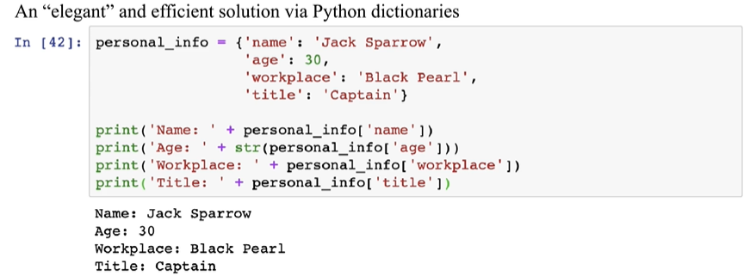
Dictionary
Dictionary
0 1 2 3 4 5 6 7 8 9 10 11 12
-13 -12 -11 -10 -9 -8 -7 -6 -5 -4 -3 -2 -1

Slide 61
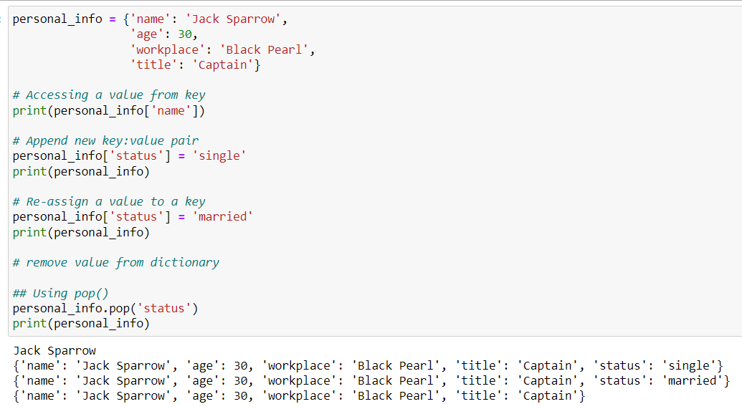
Dictionary
Dictionary
0 1 2 3 4 5 6 7 8 9 10 11 12
-13 -12 -11 -10 -9 -8 -7 -6 -5 -4 -3 -2 -1

Slide 62
Roadmap
Introduction
Objects, Variables, and Data Types
Strings
Control Flow: Boolean Type

Slide 63
Control Flow: Boolean Type
The Boolean Type Expressions
Status:
True
or
False
Comparison operators
Operators
Remarks
Example
==
Equal
Not equal
Greater than or equal to Smaller than or equal to Greater than
Smaller than
x == y x != y x >= y x <= y x > y
x < y
!=
>=
<=
>
<

Slide 64
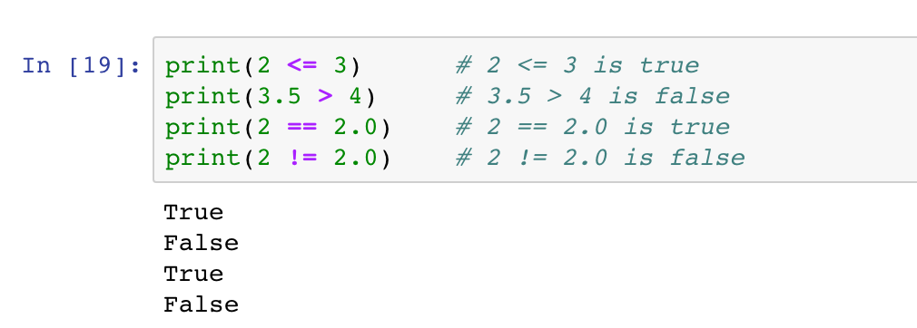
Control Flow: Boolean Type
The Boolean Type Expressions
Status:
True
or
False
Comparison operators

Slide 65
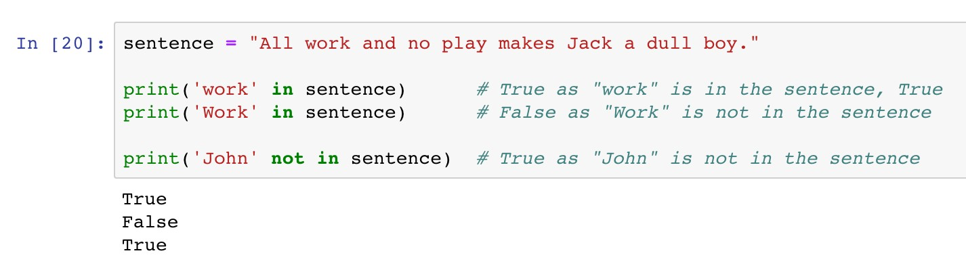
Control Flow: Boolean Type
The Boolean Type Expressions
Status:
True
or
False
Membership operators

Slide 66
Control Flow: Boolean Type
The Boolean Type Expressions
Status:
True
or
False
Logic operators
Operators
Remarks
Examples
x >= 1 and y <= 1
< 1
and
Returns True if
both statements are True
Returns True if either one statements is True
Reverse the result, returns False if the result
or
x > 1 or y
not x == 0
not

Slide 67
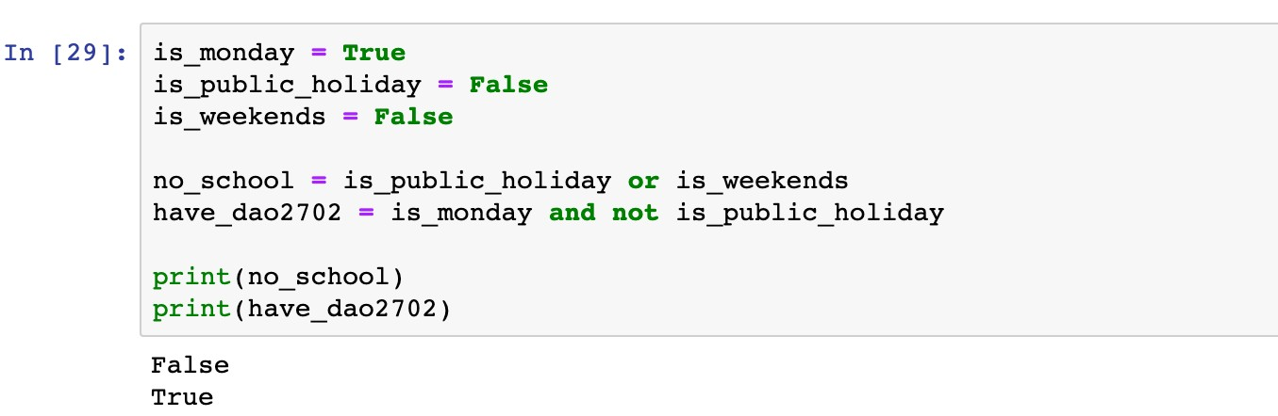
Control Flow: Boolean Type
The Boolean Type Expressions
Status:
True
or
False
Logic operators
The condition is True if at least one statement is True
The condition is True if both statements are True

Slide 68
Roadmap
Introduction
Objects, Variables, and Data Types
Strings
Control Flow: if

Slide 69
Control Flow: from Boolean Type…
Conditional Statements
The
if-elif-else
syntax enables diﬀerent actions according
to the status of given boolean expressions.

Slide 70
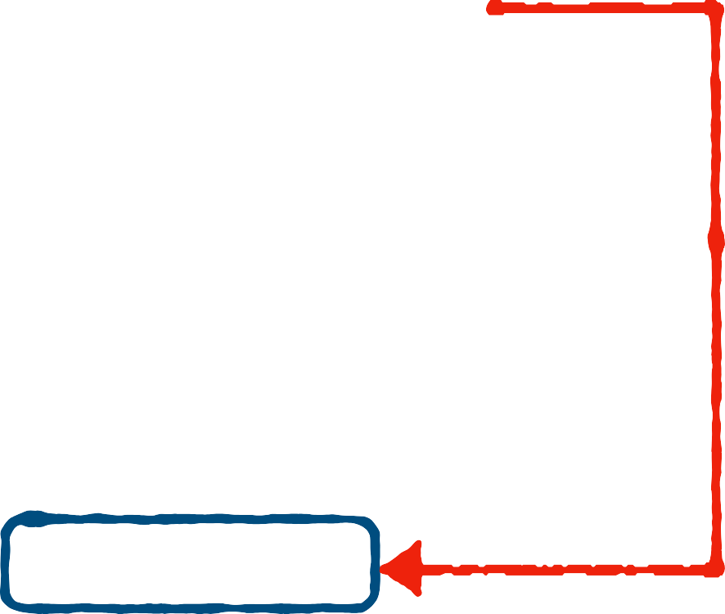

Control Flow: if
Conditional Statements
if
<boolean statement 1>:
<code body 1>
<code body 2>
The
if
syntax
if
Keyword
Execute <code body 1> if
<boolean statement 1> is and skip it if otherwise
Indent (a tab or four spaces)
<code body 1> to diﬀerentiate it from <code body 2>
if
False
<boolean statement 1>:
True
<code body 1>
True,
<code body 2>

Slide 71

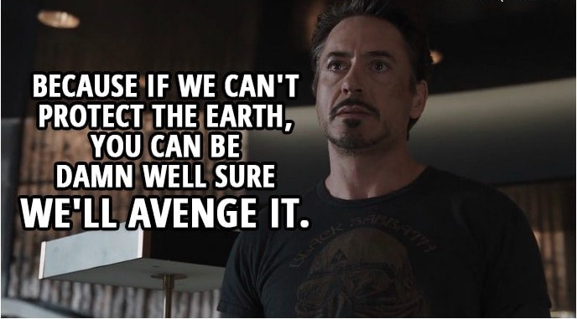
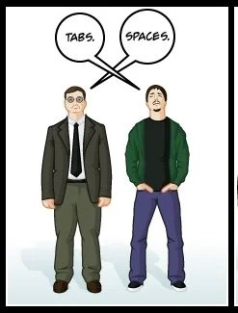
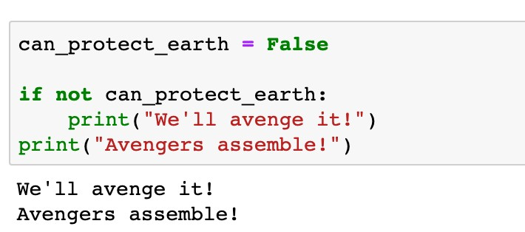
Control Flow: if
Conditional Statements
The
if
syntax
Execute this line if the condition is True
Do not forget the colon
Keyword
Indentation (a tab or four spaces)
This line is out of the conditional statement

Slide 72
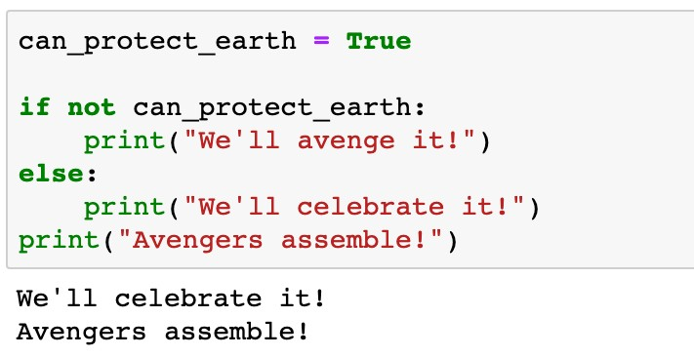
Control Flow: if
Conditional Statements
The
if
syntax
What is the printed message if
is
can_protect_earth
True

Slide 73
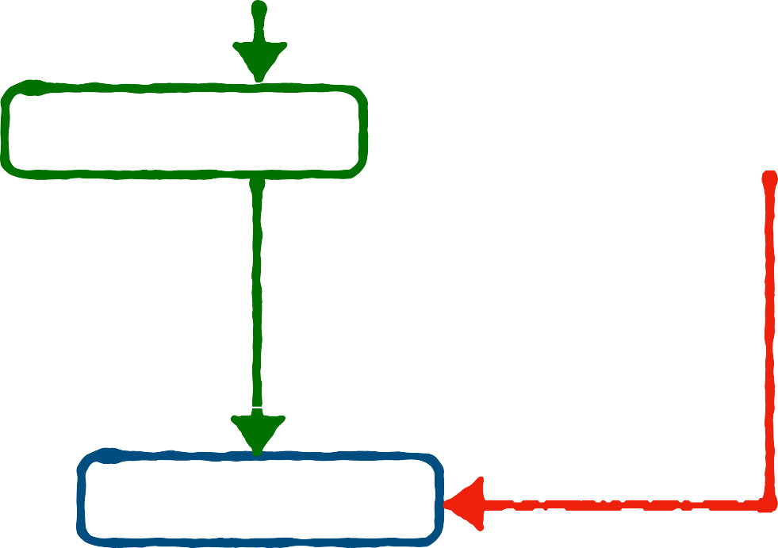
Control Flow: if-else
Conditional Statements
if
<boolean statement 1>:
<code body 1>
:
<code body 2>
<code body 3>
False
<boolean statement 1>:
The
if-else
syntax
else
if
else
Keyword and
Execute <code body 1> if
<boolean statement 1> is
Execute <code body 2> if
<boolean statement 1> is
Same indentations for
if
True
True
<code body 1>
else
: <code body 2>
False
else
<code body 3>

Slide 74
Control Flow: if-else
Conditional Statements
The
if-else
syntax
Execute this line if the condition is False
Indentation (a tab or four spaces)

Slide 75

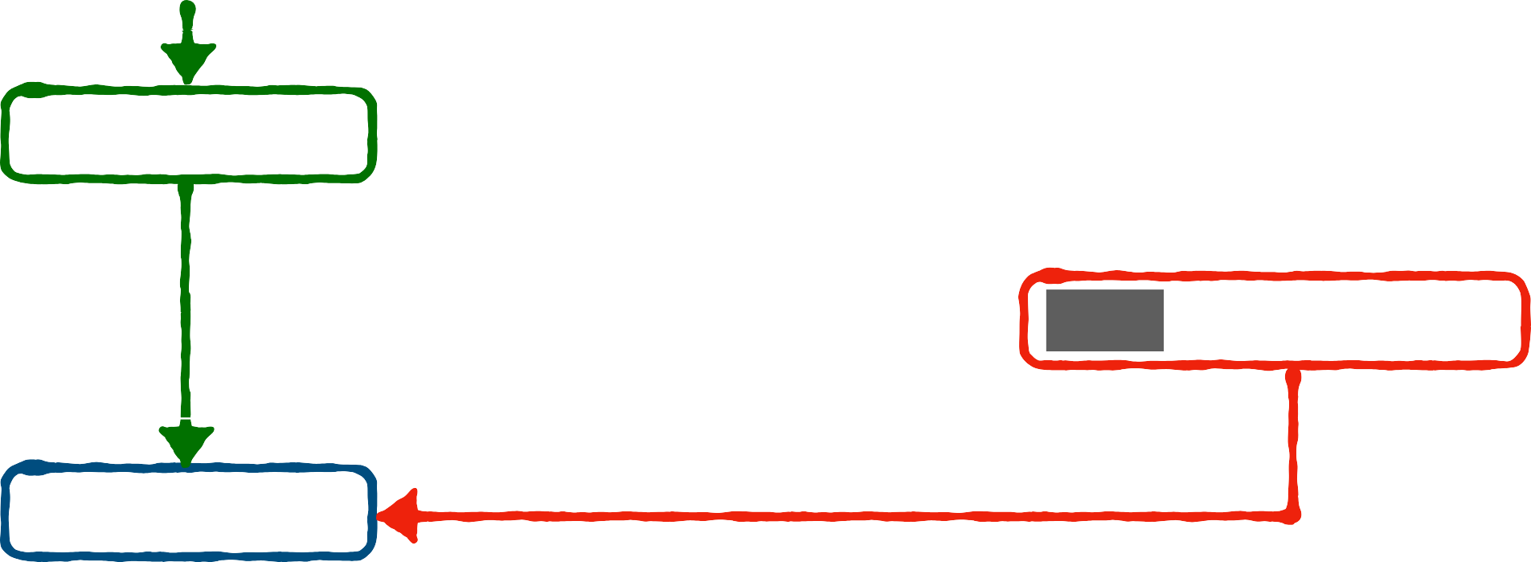


Control Flow: if-elif-else
Conditional Statements
if
<boolean statement 1>:
<code body 1>
The
if-elif-else
syntax
elif
: <boolean statement 2>:
<code body 2>
Keyword elif to add more conditions
else
:
<code body 3>
<code body 4>
False
<boolean statement 1>:
if
True
<code body 1>
elif
<boolean statement 2>:
False
True
<code body 2>
else
: <code body 3>
<code body 4>

Slide 76
Roadmap
Introduction
Objects, Variables, and Data Types
Strings
Control Flow: while

Slide 77


Control Flow: while
Iterations and loops
while
<boolean statement>:
<code body to be repeated>
<other code>
The
while
loop
while
Keyword
Check the status of
<boolean statement> in each iteration
Repeatedly Execute <code to be repeated> if <boolean statement> is
Same indentations for
<code to be repeated>
while
False
<boolean statement>:
True
<code to be repeated>
True
<other code>

Slide 78


Control Flow: while
Iterations and loops
The
while
loop

Slide 79



Control Flow: while
Iterations and loops
The
while
loop
Example 1
In the movie Dr. Strange (2016), Steven Strange beat the supervillain "Dormammu" by keeping annoying him until he was extremely bored and frustrated. Write a program to act like Dr. Strange. The "time" loop can only be broken when you type in "I quit" or "You win".
False
<boolean statement>:
True
<code to be repeated>
while
<other code>

Slide 80


Control Flow: while
Iterations and loops
The
while
loop
Example 1
In the movie Dr. Strange (2016), Steven Strange beat the supervillain "Dormammu" by keeping annoying him until he was extremely bored and frustrated. Write a program to act like Dr. Strange. The "time" loop can only be broken when you type in "I quit" or "You win".
False
Dormammu not quit:
True
I’ve come to bargain What does Dormammu say?
Movie ends
while

Slide 81



Control Flow: while
Iterations and loops
while
False
Dormammu not quit:
The
while
loop
True
I’ve come to bargain What does Dormammu say?
Movie ends
I’ve come to bargain What does Dormammu say?
Movie ends
An inner conditional statement to check if Dormammu quits
True
Check the condition in each iteration
Change the boolean status to stop the loop
Extra Indentation
Extra Indentation
Loop body
Indentation
Execute if the boolean condition is True
Execute if the boolean condition is False

Slide 82

Control Flow: while
Iterations and loops
The
while
loop
Example 1
In the movie Dr. Strange (2016), Steven Strange beat the supervillain "Dormammu" by keeping annoying him until he was extremely bored and frustrated. Write a program to act like Dr. Strange. The "time" loop can only be broken when you type in "I quit" or "You win".

Slide 83


Control Flow: while
Iterations and loops
while
True:
The
while
loop
True
I’ve come to bargain
if Dormammu says “quit” ?
True
break
Movie ends
Always True
Stop the loop immediately
Indentation
Loop body

Slide 84
Control Flow: while
Iterations and loops
The
while
loop
while
Keyword
Indentations for the code block to be repeated
Stoping criterion
Indefinite iterations (unknown number of iterations)

Slide 85
Roadmap
Introduction
Objects, Variables, and Data Types
Strings
Control Flow: for

Slide 86


Control Flow: for
Iterations and loops
The
for
loop
for
<item> in <sequence>:
<code body to be repeated>
<other code>
for
in
Keywords and
In each iteration, <item> takes one value from
<sequence>
The number of iterations is the number of values in <sequence>
Same indentations for
<code to be repeated>
for
<item>
in
<sequence>:
<item> takes one value
<code to be repeated>
Loop stops
<other code>

Slide 87




Control Flow: for
Iterations and loops
for
i
in
Dormammu_says_quit
Loop stops
The
for
loop
“Dormammu: I do not quit * (i+1)”
Example 2
Dr. Strange & Dr. Dormammu
Dormammu: I quit, you win!
Dr. Strange: Wise choice bro!

Slide 88
Control Flow: for
Iterations and loops
for
i
in
Dormammu_says_quit
Loop stops
The
for
loop
“Dormammu: I do not quit * (i+1)”
Example 2
Dr. Strange & Dr. Dormammu
Dormammu: I quit, you win!
Dr. Strange: Wise choice bro!
Take each number from name in each iteration
Indentation
Loop body

Slide 89
Control Flow: for
Iterations and loops
The
for
loop
Doramammu_says_quit
0 | 1 | 2 | … | n-2 | n-1
Example 2
Dr. Strange & Dr. Dormammu

Slide 90
Control Flow: for
Iterations and loops
Comparison between
while
for
loop
loop
Definite iteration
A counter is updated through the loop
loop and
while
loop
for
Indefinite iteration
A counter can be defined and manually updated
Break the loop by
break
Skip the code by
continue

